Slide 1
Navigating pandemic supply challenges
Team ID: 2230672

Slide 2
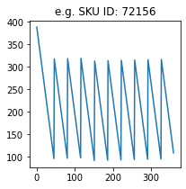
Executive Summary
Inventory Management
Objectives
Calculate Obsolete Inventory
Find Change in Inventory Position
Model Considered:
Deterministic Demand
Inventory Level
Unknown Parameters:
Economic Order Quantity
Order Aggregation
Constant APU after considering trend_{APU}
Initial On order Inventory = 0
Reason: Model considered is Deterministic Demand.
This is based on the forecasting methods followed in supply chains of fragile goods.
Reason: No explicit data mentioned in Exhibit 2
Assumptions
Initial and Final Back order Inventories = 0
Reason: No data in Exhibit 2 regarding
Initial Back order Inventory
Final Lead Time after considering S-OTD thus leading to no specific way to simulate arrival delay in model

Slide 3
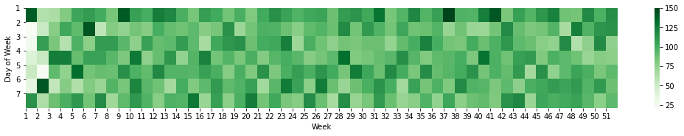

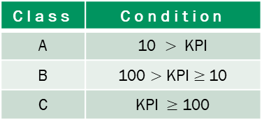
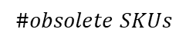
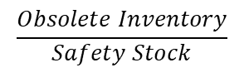
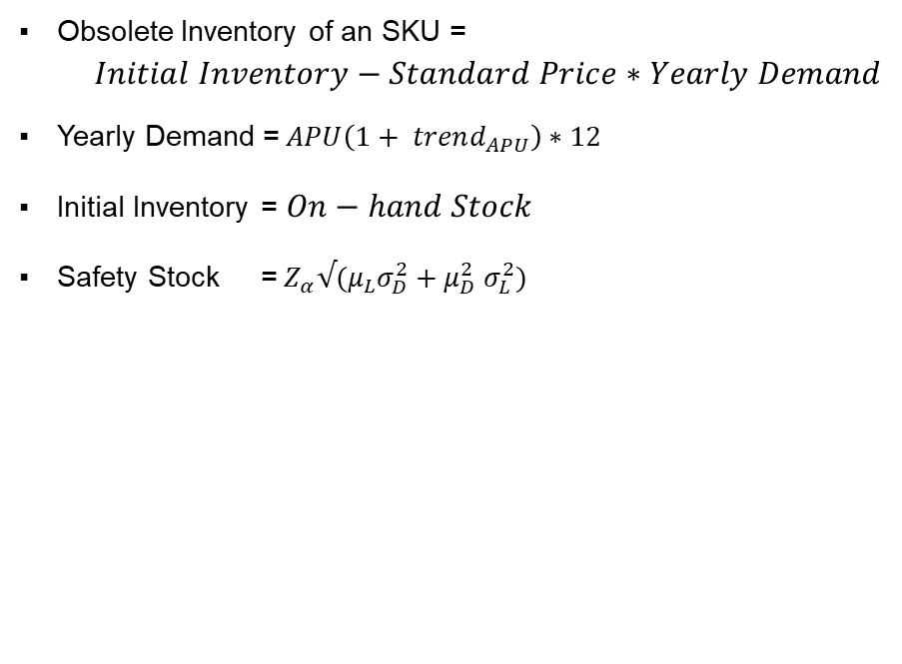
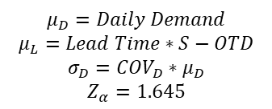
Obsolete Inventory
Formulae used for derivation :
Unaccounted parameters for Cost Reduction
Obsolete Inventory of an SKU = $Initial Inventory−Standard Price∗Yearly Demand$
Yearly Demand =$APU\left(1+ trend_{APU}\right)∗12$
Initial Inventory = $On−hand Stock$
Safety Stock =${ Z}_{α}√(μ_{L}σ_{D}^{2}+μ_{D}^{2} σ_{L}^{2})$
On average 94 SKUs are placed on order for replenishment daily
Day 1 - 1552
Heatmap of #orders
$$μ_{D}=Daily Demand$$
$$μ_{L}=Lead Time∗S−OTD$$
$$σ_{D}=COV_{D}∗μ_{D}$$
$$Z_{α}=1.645$$
Both Demand and Delivery Lead Time are
assumed to be normally distributed
Order Aggregation because of lacking data in terms of
Coordinated Transportation for delivering multiple SKUs
For SKUs sourced from single supplier :
Constraint for Lot Sizes to maintain Full Truck Load
Managing Joint Economic Lot Sizes for profitability
For aggregating order arrivals from multiple suppliers :
Information systems to organize dispatches based on lead times
Economic Order Quantity due to absence of data on
Holding Cost
Supplier Discounting Schedule
Defined KPI
$$\frac{Obsolete Inventory}{Safety Stock}$$
117.36 %
$$\#obsolete SKUs$$
32
Class | Condition
A | 10 $>$ KPI
B | 100 $>$ KPI $≥$10
C | KPI $≥$ 100
Ordering Fixed Cost
Potential 32 obsolete SKUs result to a Total Obsolete Inventory of $ 50,140.797

Slide 4
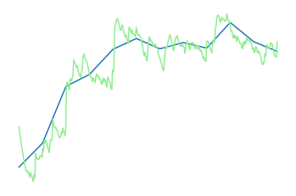
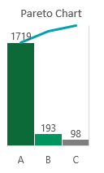
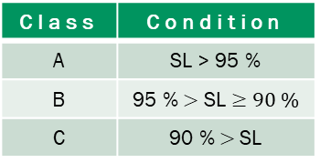
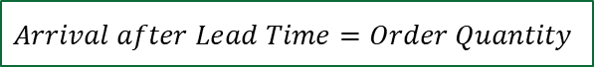
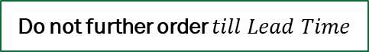
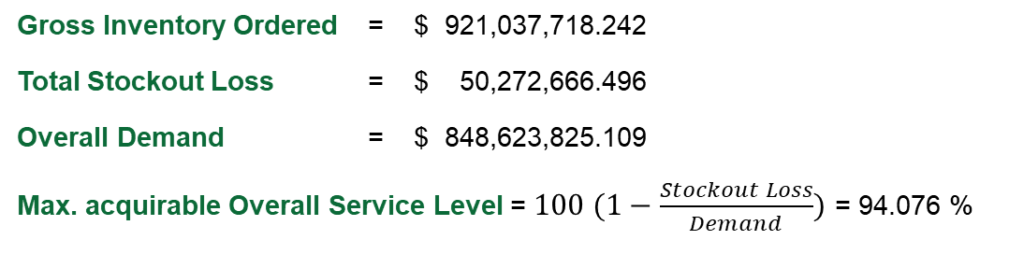
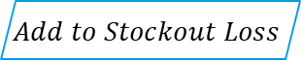
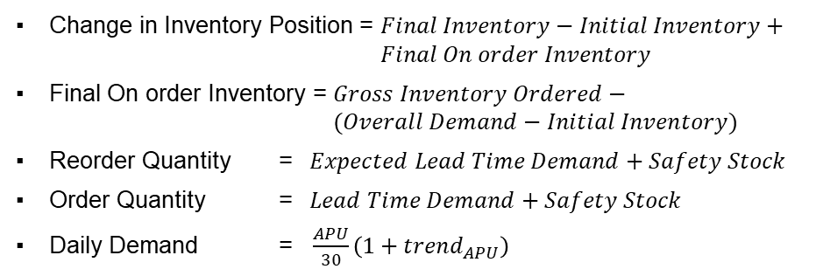
Working Capital Impact
Observed SCM Metrics
Inventory Management Schema for SKUs
Gross Inventory Ordered = $ 921,037,718.242
Total Stockout Loss = $ 50,272,666.496
Overall Demand = $ 848,623,825.109
Max. acquirable Overall Service Level = $100 (1−\frac{Stockout Loss}{Demand})$ = 94.076 %
97.696%
$$Inventory_{t}=Inventory_{t−1} −Demand+Arrival$$
Average
Service Level
Make 0
If negative
$$Add to Stockout Loss$$
$$\text{IF} Inventory_{t}≤Reorder Quantity$$
$$Arrival after Lead Time=Order Quantity$$
$46,008,199.786
$80,738,869.44
$118,422,092.919
Initial Inventory
Final Inventory
Final On order Inventory
For all 360 days
Do not further order $till Lead Time$
$
Formulae used for calculation :
100%
ABC Classification
92M
Change in Inventory Position = $Final Inventory−Initial Inventory+ Final On order Inventory$
Final On order Inventory = $Gross Inventory Ordered− (Overall Demand−Initial Inventory)$
Reorder Quantity = $Expected Lead Time Demand+Safety Stock$
Order Quantity = $Lead Time Demand+Safety Stock$
Daily Demand = $\frac{APU}{30}\left(1+trend_{APU}\right)$
Avg.
Class | Condition
A | SL > 95 %
B | 95 % $>$ SL $≥90 \%$
C | 90 % $>$SL
70M
85%
Daily Inventory
Level
10%
5%
24M
days
* SL – Service Level
0
137
360
Value of Assets under Inventory shall increase by $ 153,152,762.573

Slide 5
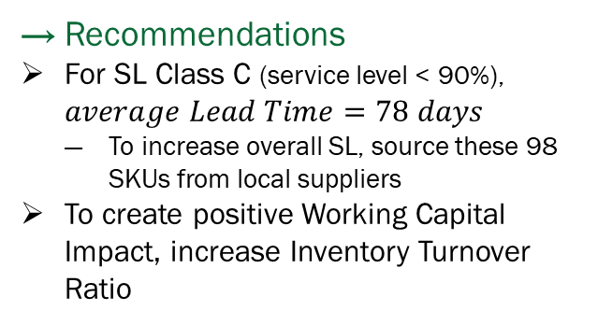
Conclusion
Inventory Management
$ 50,140.797
Total Obsolete Inventory
From 32 obsolete SKUs
$ 153,152,762.573
Working Capital Impact
Increase of Assets under Inventory
Recommendations
For SL Class C (service level < 90%), $average Lead Time=78 days$
To increase overall SL, source these 98 SKUs from local suppliers
To create positive Working Capital Impact, increase Inventory Turnover Ratio

